Slide 1
AZ-900 Microsoft Foundation
20 Questions in 15 minutes – Part Quint (5)

Slide 2
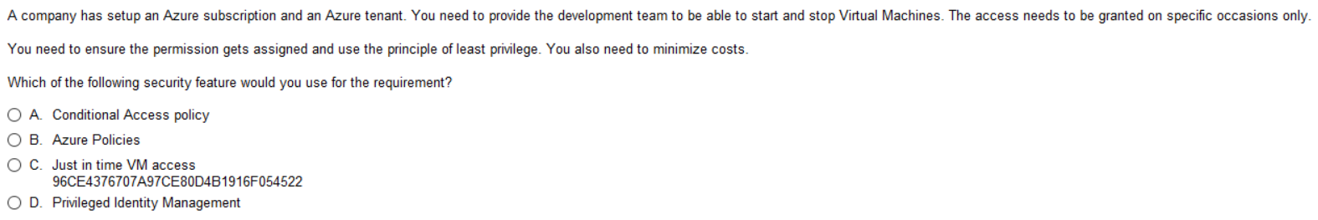
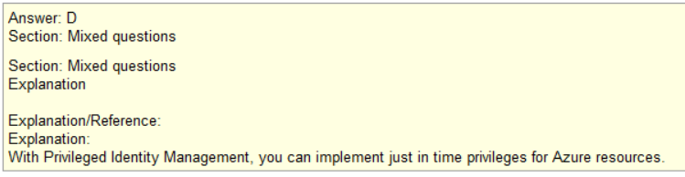
Q1
This is a feature of Privileged Identity Mgmt
maybe
No such feature

Slide 3
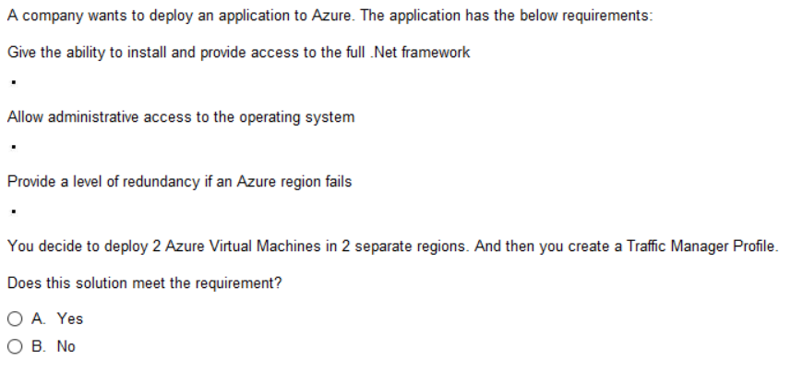
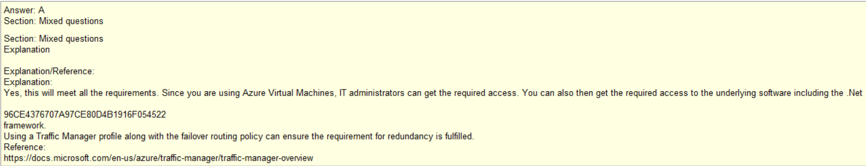
Q2
This requires admin access

Slide 4
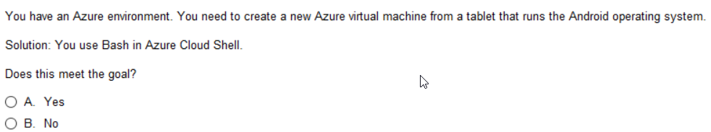
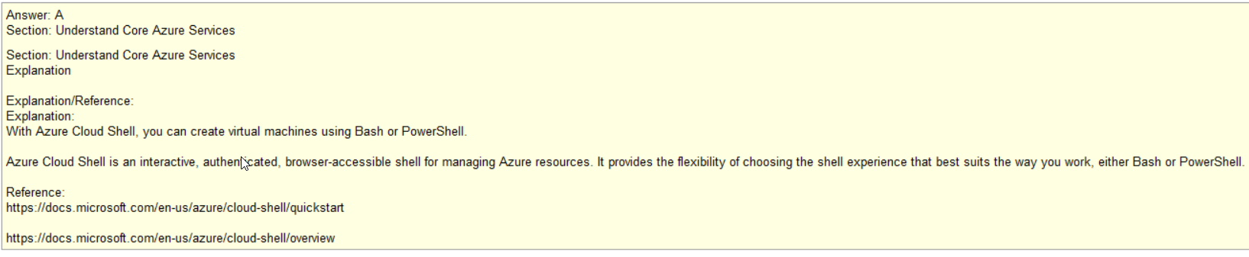
Q3
Question is can you generate AZ VM from Cloud Shell
Cloud Shell is very high level capability – yes
Cloud Shell is portal (web) based so
MAC LINUX or Windows

Slide 5
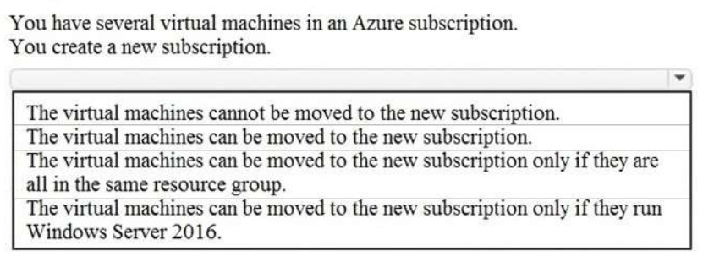
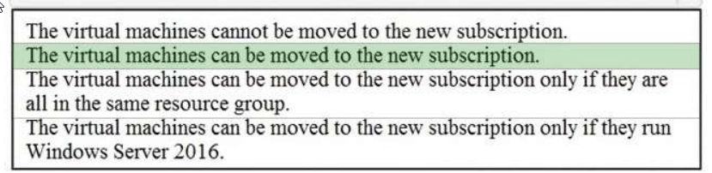
Q4
Things between subs can
generally be done
“With Sufficient thrust,
Pigs Fly just fine”

Slide 6
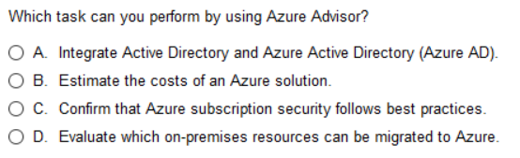
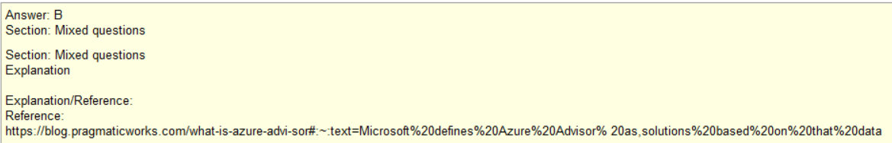
Q5
Azure AD
Azure Advisor
Compliance
Anything that can be virtualized can
be migrated. Servers/Apps – yes.
Printers for example - No.
But Advisor doesn’t help with this.
Note: Know everything Advisor does

Slide 7
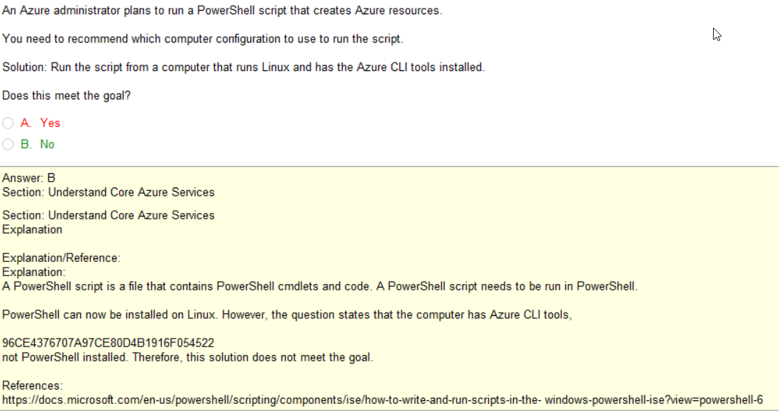
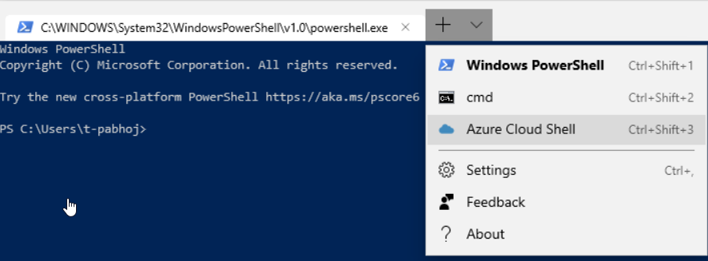
Q6
CLI is NOT PowerShell
PowerShell <> Bash shell
Note: Pay attention to what you are doing
Is it PowerShell or is it Azure CLI required?
Not running in PowerShell
Linux can have PowerShell installed
But in this case not using it

Slide 8
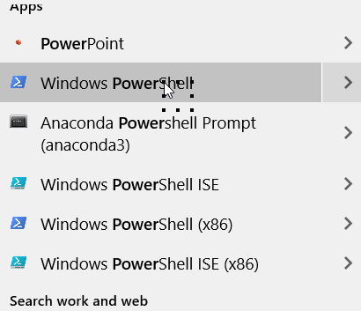
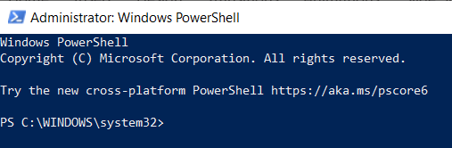
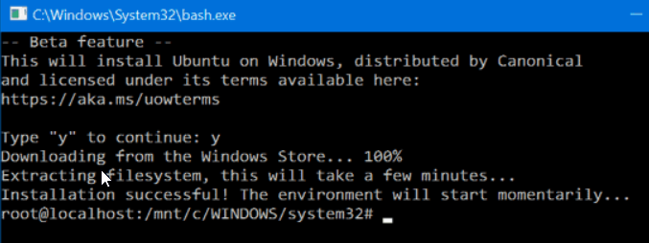
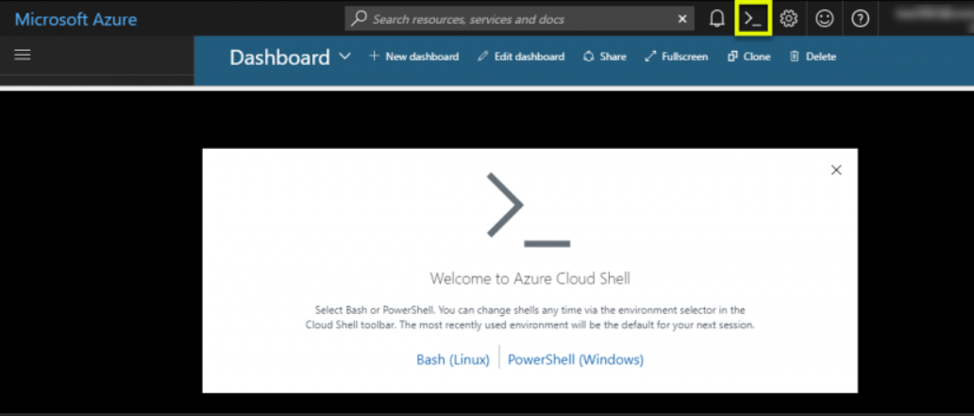
POWERSHELL – a Windows Thing primarily
Bash or K shell - OS Command Line
Usually for Windows machines OR
interfacing windows Machine components
Usually for VMs or local machine
Cloud Shell – command line for cloud (Azure) commands
You can call PowerShell and Bash shell from within Azure CloudShell

Slide 9
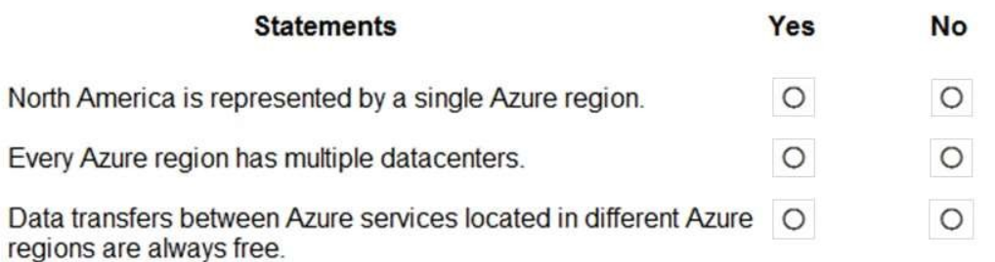
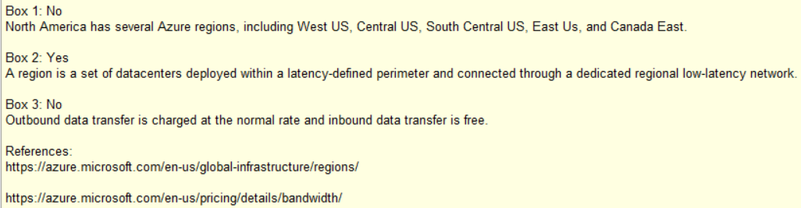
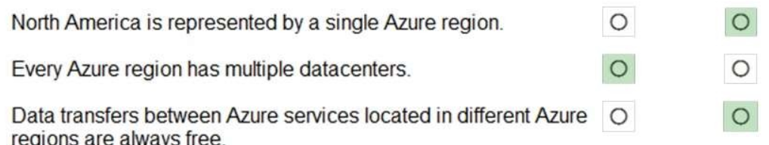
Q7

Slide 10
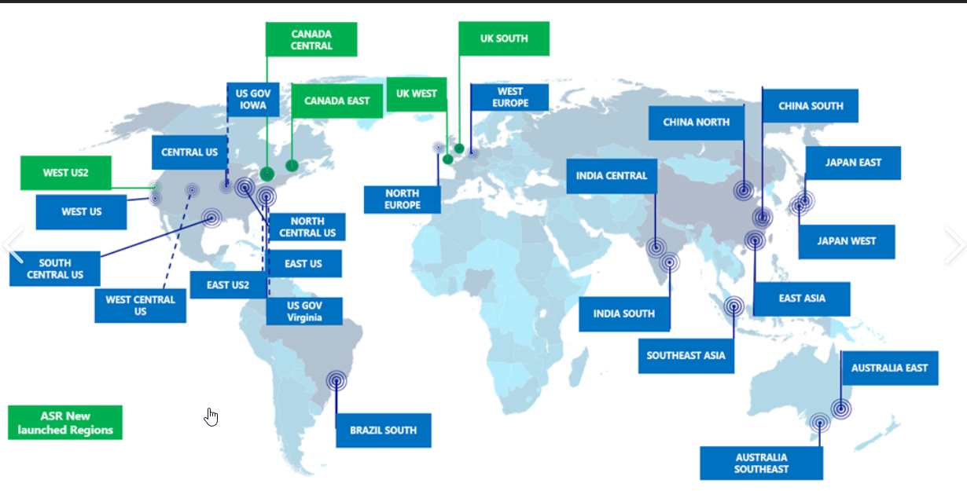
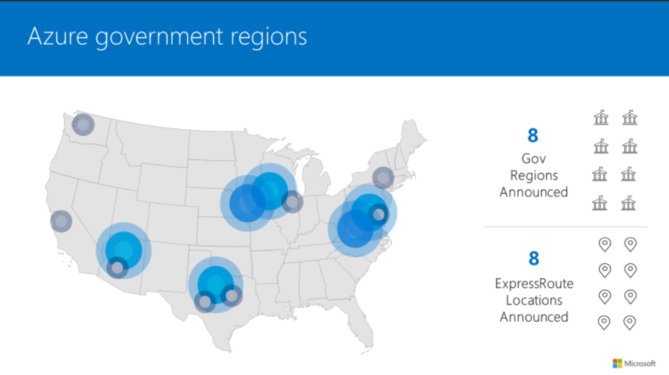
AZURE REGIONS
AZURE GOV CLOUD REGIONS

Slide 11
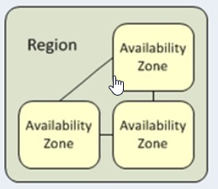
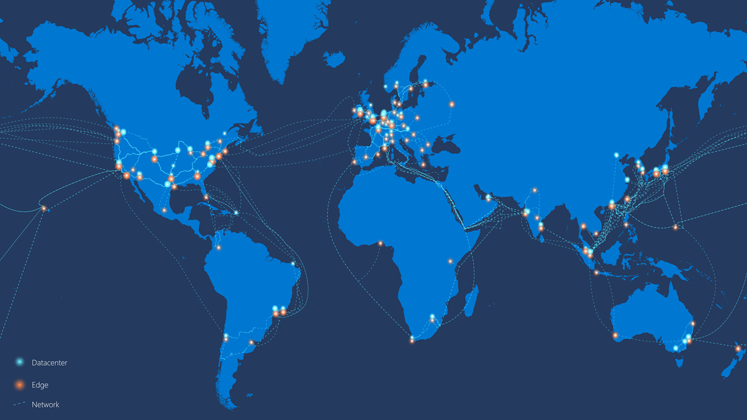
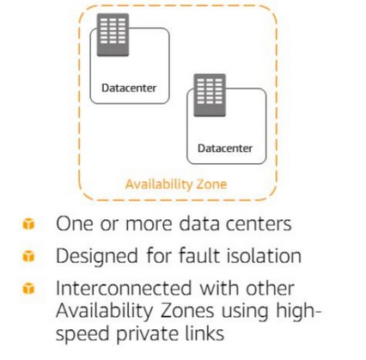
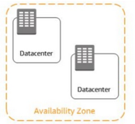
Azure RegionDC
CDN
Edge
Edge

Slide 12
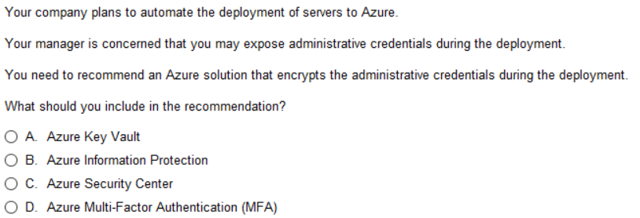
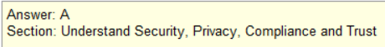
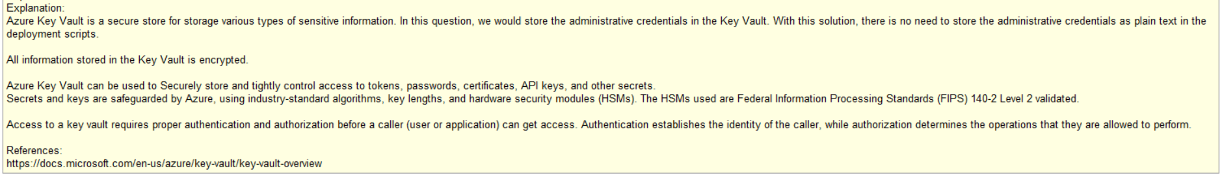
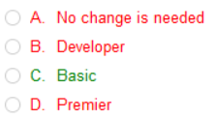
Q8
Hides/Redacts PII (ie SSN and CC info)
Section of Azure Console that hosts a number of Security Services
Two Factor Authentication

Slide 13
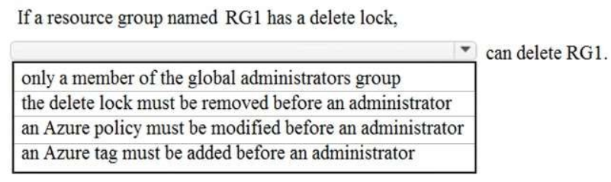
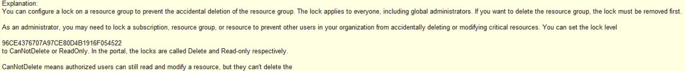
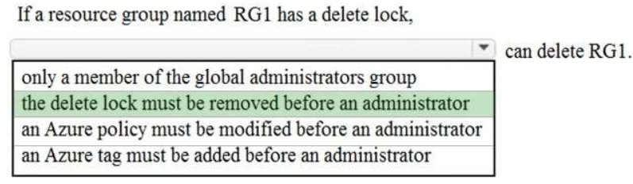
Q9
Notes: Two types of Locks
CanNotDelete
ReadOnly (Cannot Overwrite)
As an administrator, you can lock a subscription, resource group, or resource to prevent other users in your organization
from accidentally deleting or modifying critical resources. The lock overrides any permissions the user might have.
You can set the lock level to
CanNotDelete
or ReadOnly.

Slide 14
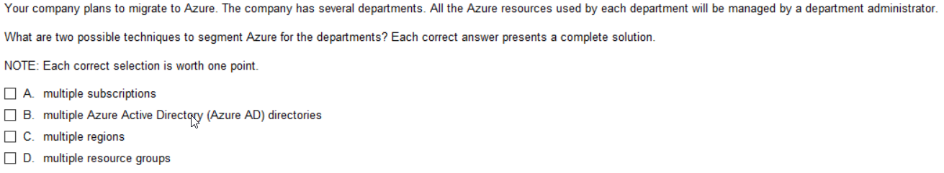
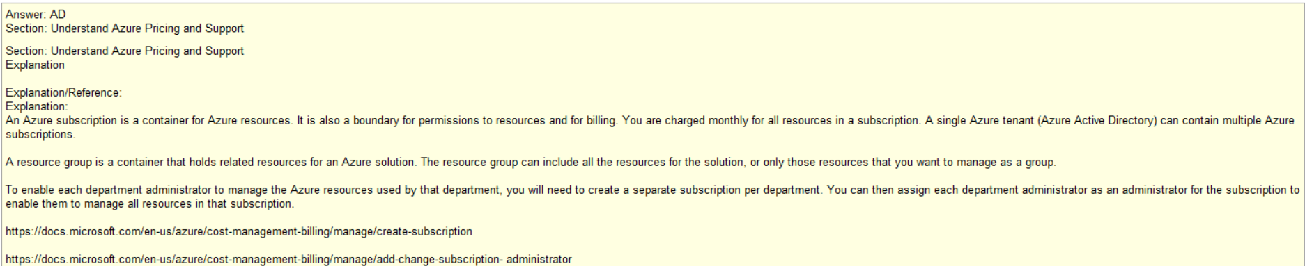
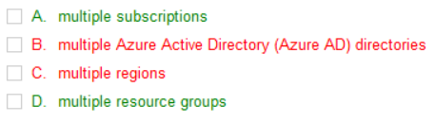
Q10
Note: Depending on your def of
Manage, you can segment costs
based on Tags if you require
You can further implement policy based on tags

Slide 15
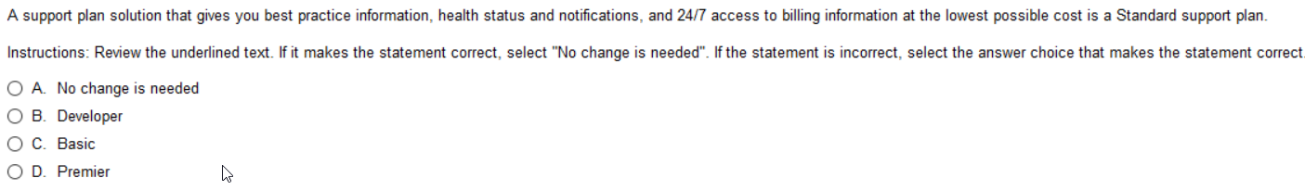
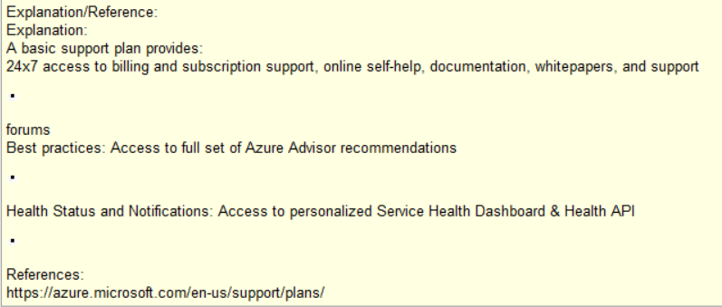
Q11
Note: Basic Plan has this, therefore
Standard plan, which is higher tier
Also has this.
Best answer

Slide 16
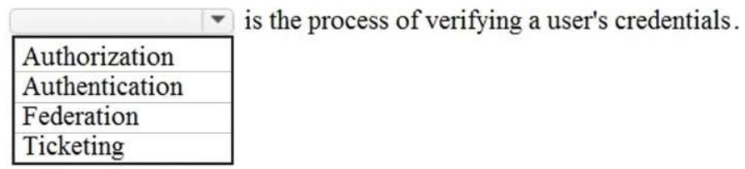
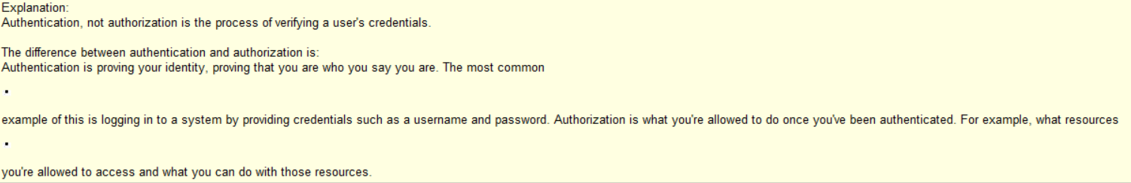
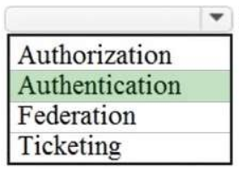
Q12
Designating what you have access to
Verifying Who you are
Sharing Permission control (ie On Prem AD and Azure AD)

Slide 17
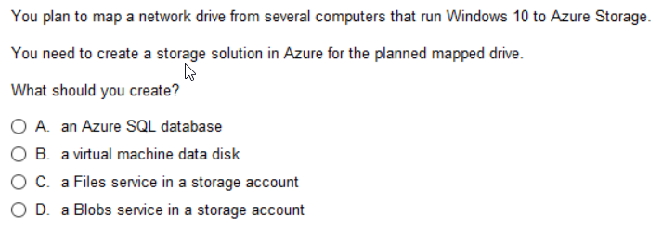
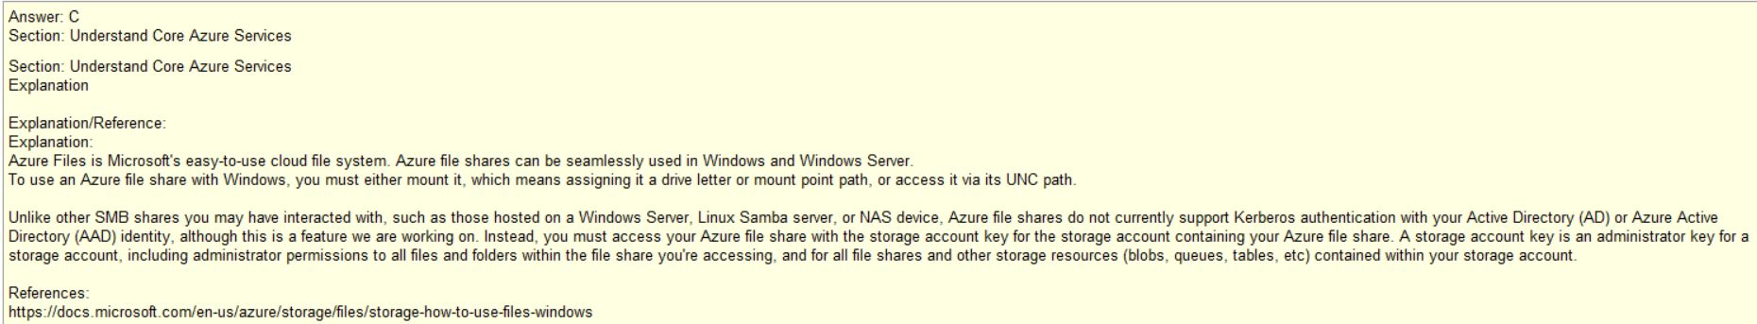
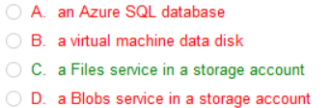
Q13
What do you store on shared network drive?
Not Azure anything
Not VM (perhaps VM related files)
Not BLOBs
FILES

Slide 18
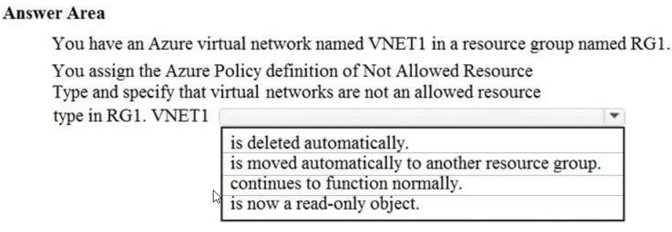
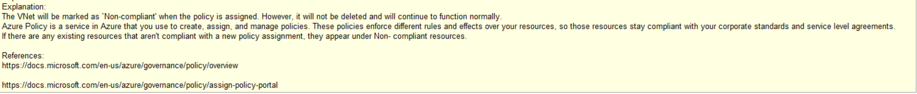
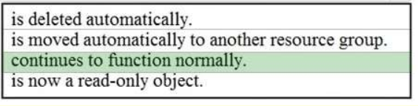
Q14
RG1
VNET1
VM1
Note: Consider that item is running and to
Delete it while it is running is “risky”.
Handled by not allowing it upon initiation
NOT while running

Slide 19
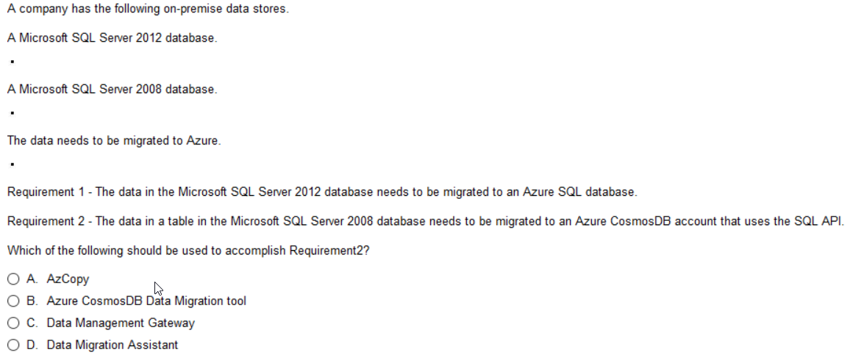
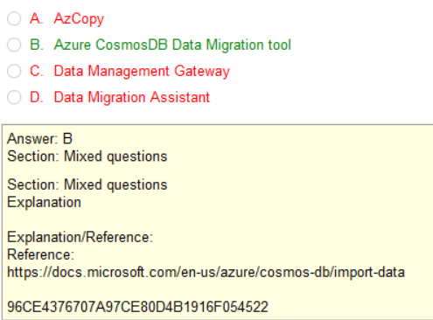
Q15
Note: Cosmos does it all.
3 in one DB
Relational
NoSQL
DocumentDB,
Just diff template applied for each type
Any of these can be used to migrate to Cosmos
when using the appropriate filter

Slide 20
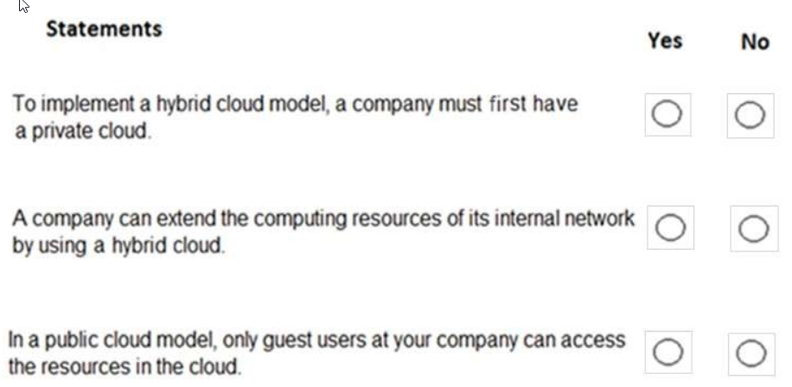
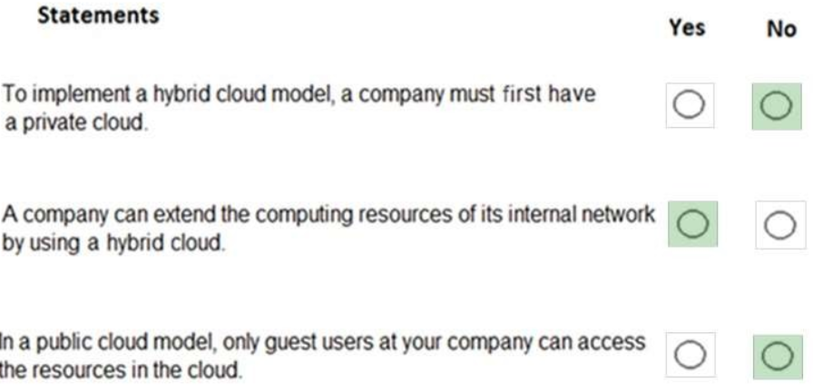

Q16
All Cloud - not hybrid
All Private - not hybrid
Textbook definition
Of Hybrid Cloud
Only guest users accessing your network?
No such thing as a “guest administrator”.

Slide 21



Q17
You could start all public or all private than add to the other
How could you access it?
Note the will try to trick you up on this.
Hybrid means a Public and Private Cloud – both can be in 3rd party DataCenter
Where it is located doesn’t dictate private or public, but who has access from where

Slide 22



Q18
Locks prevent deletion or overwrite
Perhaps, but the role would be implemented using policy
Perhaps, but the tag would be implemented using policy

Slide 23



Q19
If you believe this, I got a some beachfront real-estate in AZ to sell you!

Slide 24



Q20
Virtual Networks segregate traffic virtually
OS doesn’t matter, Linux can talk to Windows can talk to Cloud
Resource Groups can share Virtual Networks
Multiple network interfaces can be programmed to talk to each other

Slide 25
APPENDIX – KEY AREAS of RECAP TO KNOW
Tips: Do the Simulator Questions - both sets 100q and 254q respectively
When you understand this enough to make an 80% - you are ready
See Simulator setup instructions, files only need to be in same dir as exe
Mail me with gmail or NON IBM account and I will add you to my global gmail account link. Using this to avoid any copyright affiliations with IBM

Slide 26




The Simulator
These files must all
Be in same directory
Add the vce files
Launches Simulator
Send me a gmail email and I will send you link to simulator, and vce files

Slide 27


Slide 28

Significant Influence
Over Environment
Limited Influence
Over Environment
(Scaling, Location)
Zero Influence
Over Environment
Azure
You
DBMS
Note: Server vs Serverless
-totally stateless
-deployed on demand
-typically small footprint
Virtual Machine
Hard Drive/Space
DBMS (you install
And configure)
Azure Cosmos DB, App Service, CDN
Email
Office (Web)
www.Amazon.com

Slide 29


ExpressRoute
Dedicated Link from your facility to Microsoft Cloud
Often implemented as MPLS circuit
MPLS
EXPRESSROUTE
Japan
Hawaii
Hamburg
London
MPLS
Dubai
Paris
NYC
Boston
Geneva

Slide 30
AZURE REGIONS
AZURE GOV CLOUD REGIONS

Slide 31
Azure DataCenters/Edge Locations
CDN
Edge
Edge

Slide 32

Classification Types of Azure Storage

Slide 33


Slide 34


Slide 35



Slide 36

Locally redundant storage
Zone-redundant storage
Zone-redundant storage
Read-access geo-redundant storage

Slide 37


Slide 38

https://azure.microsoft.com/en-us/support/plans/
Tip: Commit to memory the variances

Slide 39

Preview
There are two types of previews, private and public.
Private preview is only available to certain Azure customers for evaluation purposes.
The public preview is available to all Azure customers.
Azure may include preview, beta, or other pre-release features, services, software, or regions offered by Microsoft to obtain customer feedback ("Previews"). Previews are made available to you on the condition that you agree to these terms of use, which supplement your agreement governing use of Azure.
Announce EOL
S
NO SLA, NO SUPPORT |
NO SLA, NO GUARANTEED SUPPORT |
SLA, SUPPORT
EOL Support
Public
Preview
Public
12 months
Private
Preview

Slide 40

Q11
Tip: CosmosDB can be what you want it to be:
CosmosDB is really three different DBs in one
NoSQL – taking strings like JSON
SQL – handling relational DB Document DB
Read the cosmos-db intro
AWS has about 10 different DB.
Azure pretty much sticks with Cosmos
.

